Slide 1
Cornerstone City Church Peninsula Plus Community Hoo Are Ya
22nd February 2026

Slide 2
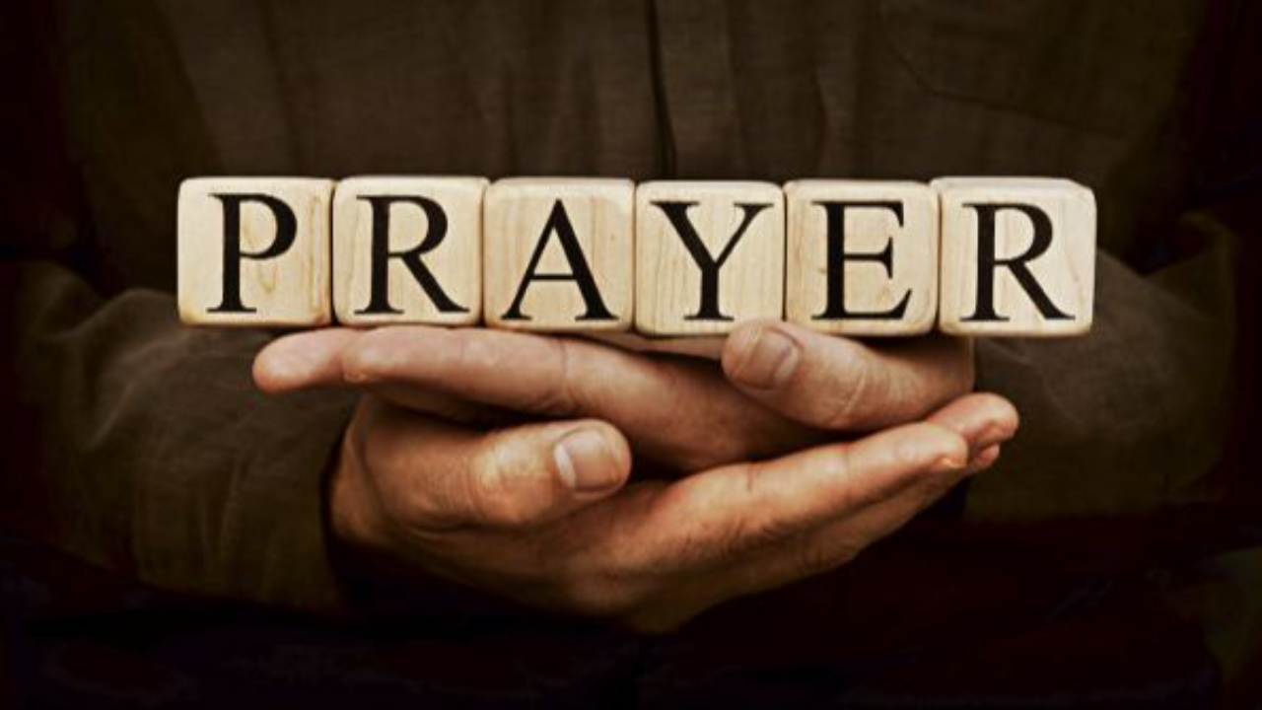

Slide 3
Everlasting God
CCLI Song # 4556538
Brenton Brown | Ken Riley
© 2005 Thankyou Music (Admin. by Integrity Music Ltd)
For use solely with the SongSelect® Terms of Use. All rights reserved. www.ccli.com
CCLI Licence No. 33265

Slide 4
1/3
Strength will rise as we wait upon the Lord
We will wait upon the Lord
We will wait upon the Lord
Strength will rise as we wait upon the Lord
We will wait upon the Lord
We will wait upon the Lord

Slide 5
2/3
Our God You reign forever
Our Hope our strong Deliv'rer

Slide 6
3/3
You are the everlasting God
The everlasting God
You do not faint
You won't grow weary
You're the defender of the weak
You comfort those in need
You lift us up on wings like eagles

Slide 7
Our God
CCLI Song # 5677416
Chris Tomlin | Jesse Reeves | Jonas Myrin | Matt Redman
© 2010 sixsteps Music (Admin. by Integrity Music)
Thankyou Music (Admin. by Integrity Music)
Vamos Publishing (Admin. by Integrity Music)
worshiptogether.com songs (Admin. by Integrity Music)
Atlas Mountain Songs (Admin. by SHOUT! Music Publishing UK)
For use solely with the SongSelect® Terms of Use. All rights reserved. www.ccli.com
CCLI Licence No. 33265

Slide 8
1/4
Water You turned into wine Opened the eyes of the blind There's no one like you None like you

Slide 9
2/4
Into the darkness You shine Out of the ashes we rise There's No one like you None like you

Slide 10
3/4
Our God is greater,
Our God is stronger God You are higher than any other Our God is Healer,
Awesome in power Our God, Our God

Slide 11
4/4
And if Our God is for us,
Then who could ever stop us? And if our God is with us,
Then what can stand against?
(REPEAT)

Slide 12
You Are Good
CCLI Song # 3383788
Israel Houghton
© 2001 Integrity's Praise! Music (Admin. by Integrity Music)
Sound Of The New Breed (Admin. by Integrity Music)
For use solely with the SongSelect® Terms of Use. All rights reserved. www.ccli.com
CCLI Licence No. 33265

Slide 13
1/3
Lord You are good And Your mercy endureth forever Lord You are good And Your mercy endureth forever People from every nation and tongue From generation to generation

Slide 14
2/3
We worship You Hallelujah hallelujah We worship You for who You are We worship You Hallelujah hallelujah We worship You for who You are For You are good

Slide 15
3/3
You are good all the time All the time You are good You are good all the time All the time You are good

Slide 17
Once Again
CCLI Song # 1564362
Matt Redman
© 1995 Thankyou Music
For use solely with the SongSelect® Terms of Use. All rights reserved. www.ccli.com
CCLI Licence No. 33265

Slide 18
1/6
Jesus Christ
I think upon Your sacrifice
You became nothing
Poured out to death
Many times I've wondered
At Your gift of life
And I'm in that place once again
I'm in that place once again

Slide 19
2/6
Once again
I look upon the cross
Where You died
I'm humbled by Your mercy
And I'm broken inside
Once again I thank You
Once again I pour out my life

Slide 20
3/6
Now You are
Exalted to the highest place
King of the heavens
Where one day I'll bow
But for now
I marvel at this saving grace
And I'm full of praise once again
I'm full of praise once again

Slide 21
4/6
Once again
I look upon the cross
Where You died
I'm humbled by Your mercy
And I'm broken inside
Once again I thank You
Once again I pour out my life

Slide 22
5/6
Thank You for the cross
Thank You for the cross
Thank You for the cross my Friend

Slide 23
6/6
Once again
I look upon the cross
Where You died
I'm humbled by Your mercy
And I'm broken inside
Once again I thank You
Once again I pour out my life

Slide 24
Thank You For Saving Me
CCLI Song # 1043168
Martin Smith
© 1993 Curious? Music UK
For use solely with the SongSelect® Terms of Use. All rights reserved. www.ccli.com
CCLI Licence No. 33265

Slide 25
1/4
Thank You for saving me
What can I say
You are my ev'rything
I will sing Your praise
You shed Your blood for me
What can I say
You took my sin and shame
A sinner called by name

Slide 26
2/4
Great is the Lord
Great is the Lord
For we know Your truth has set us free
You've set Your hope in me

Slide 27
3/4
Mercy and grace are mine
Forgiven is my sin
Jesus my only hope
The Saviour of the world
Great is the Lord we cry
God let Your kingdom come
Your Word has let me see
Thank You for saving me

Slide 28
4/4
Great is the Lord
Great is the Lord
For we know Your truth has set us free
You've set Your hope in me

Slide 29


Slide 30
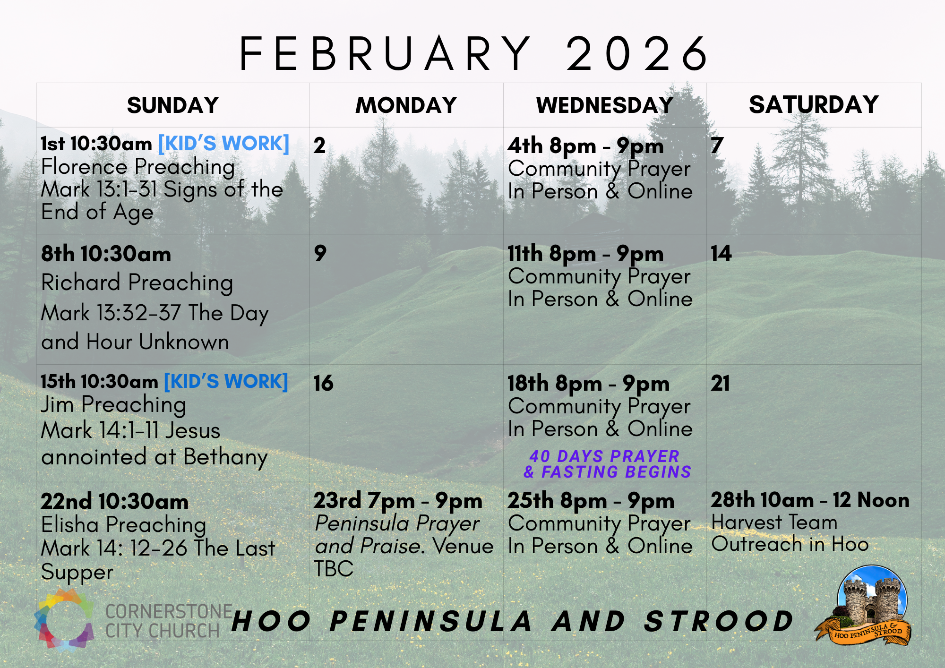

Slide 31
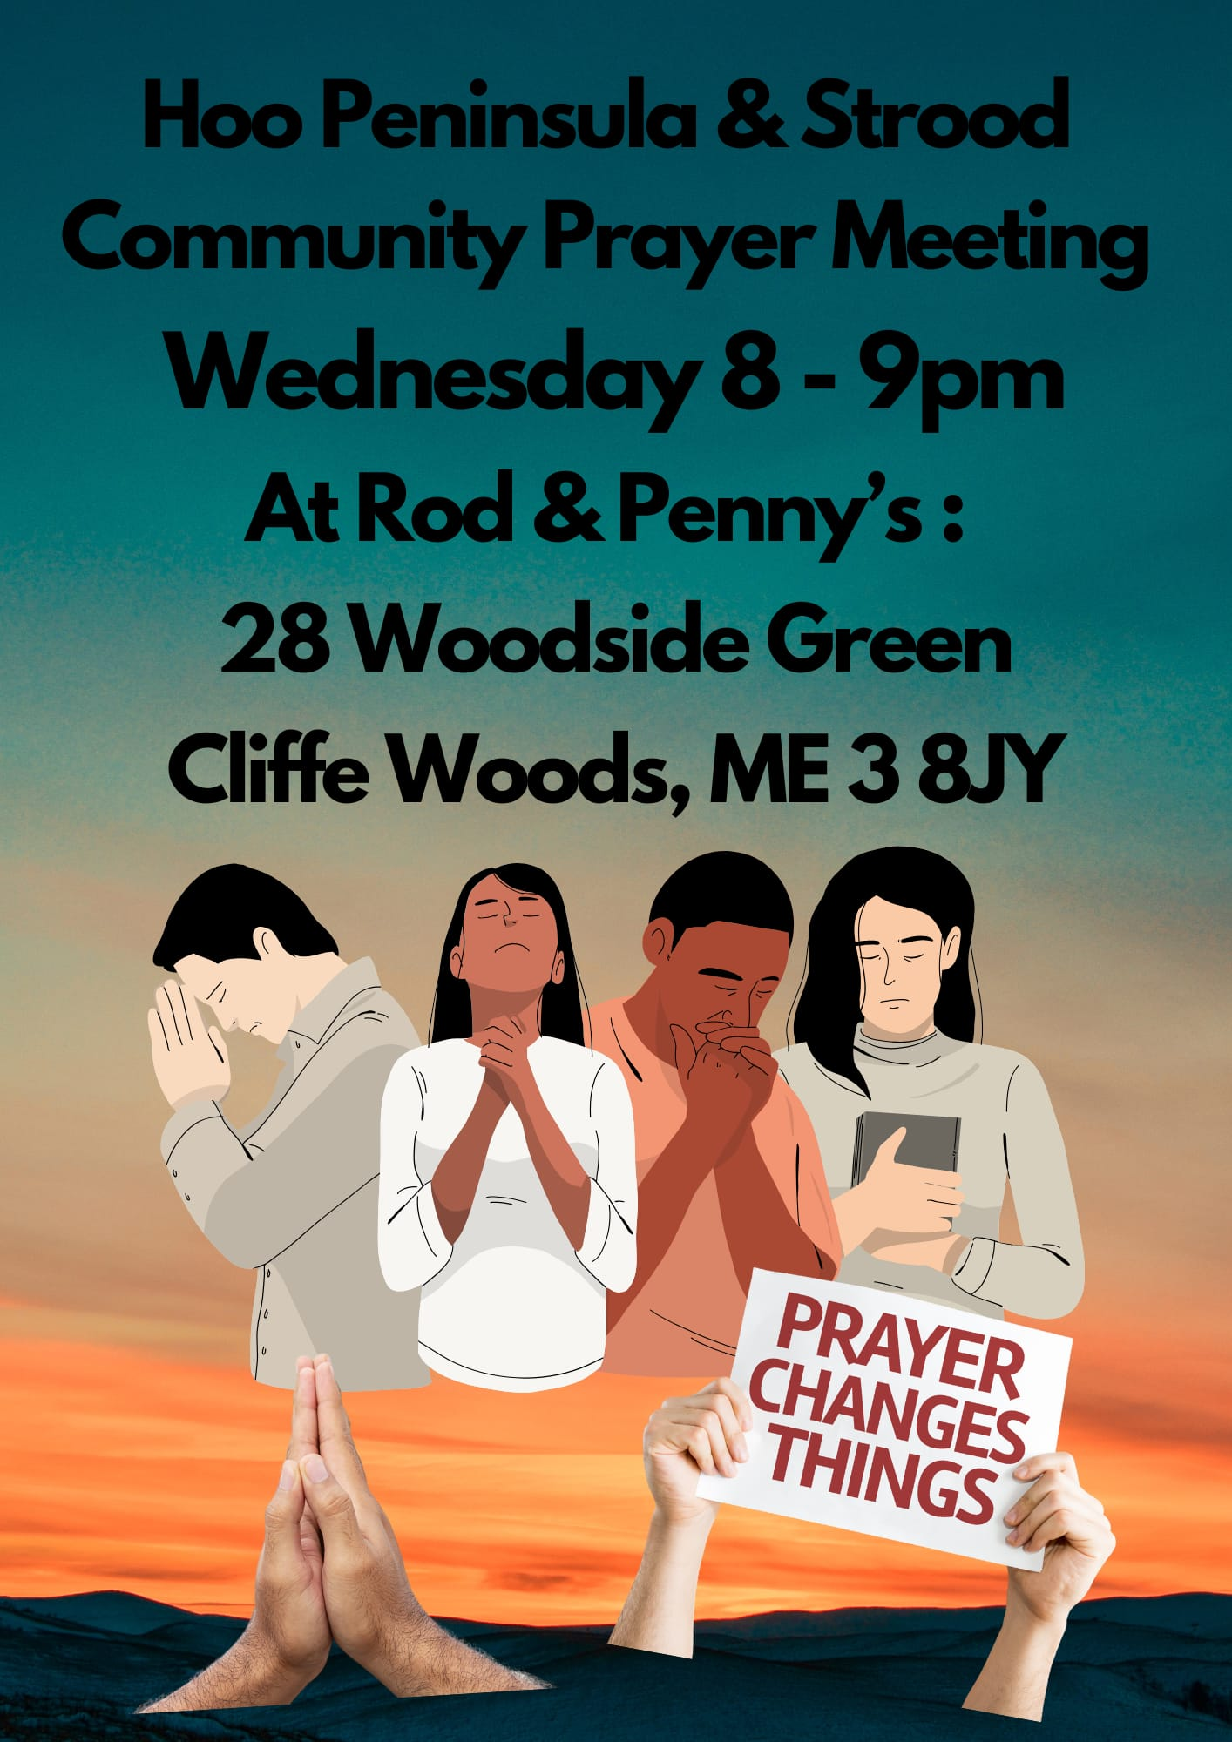

Slide 32
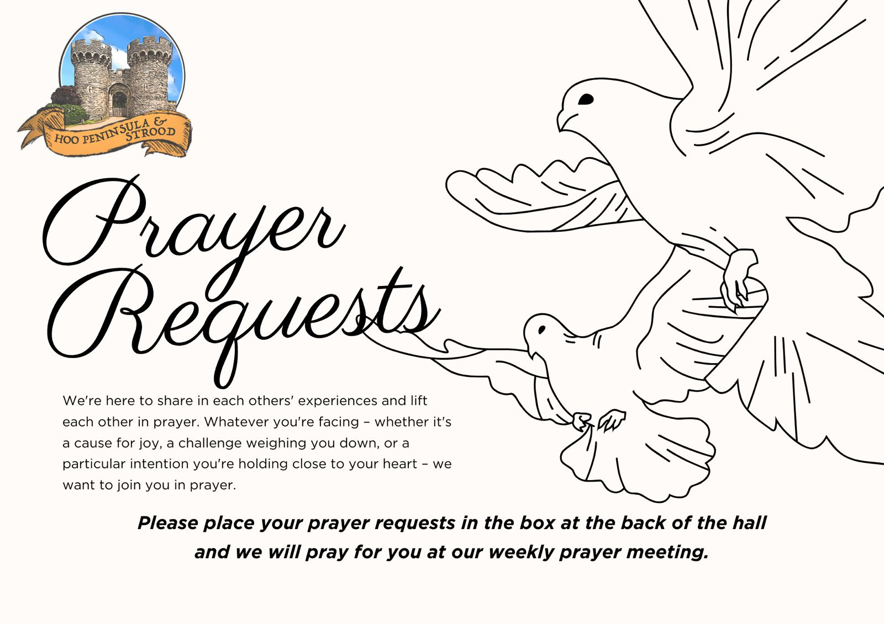

Slide 33


Slide 34
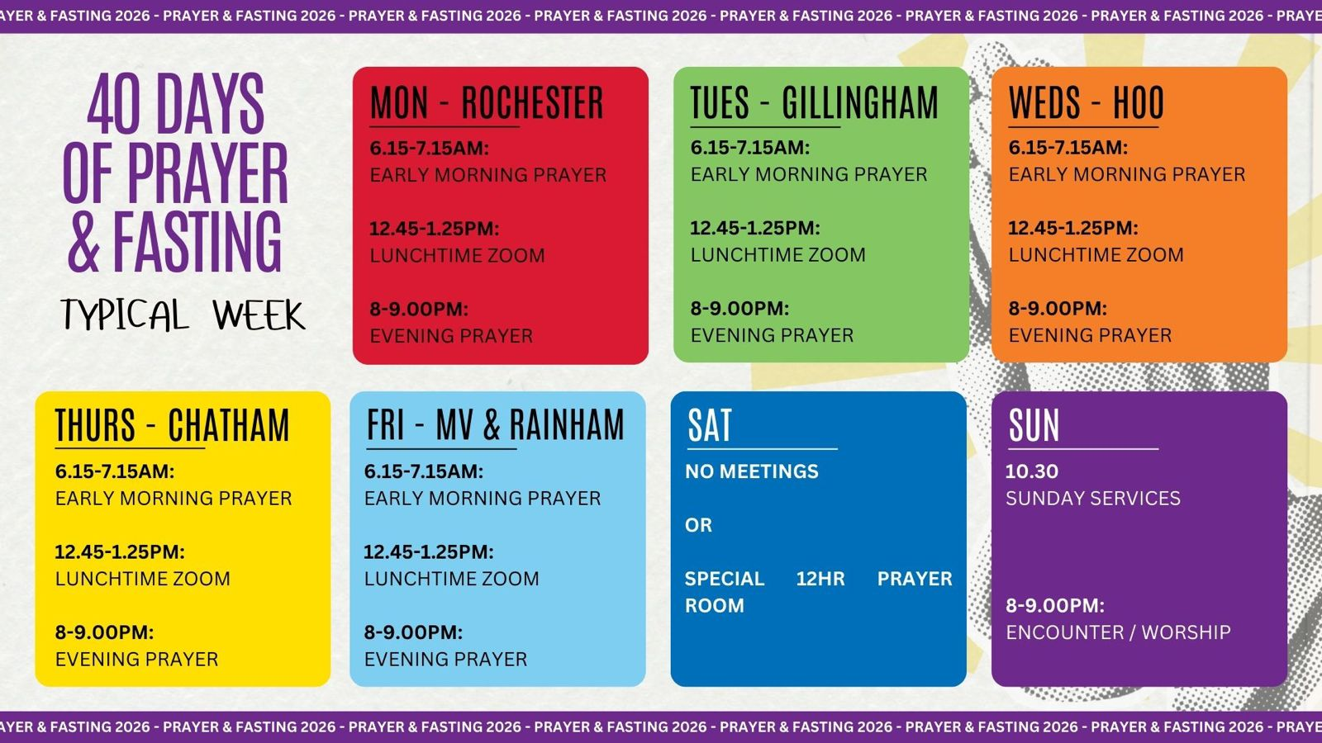

Slide 35
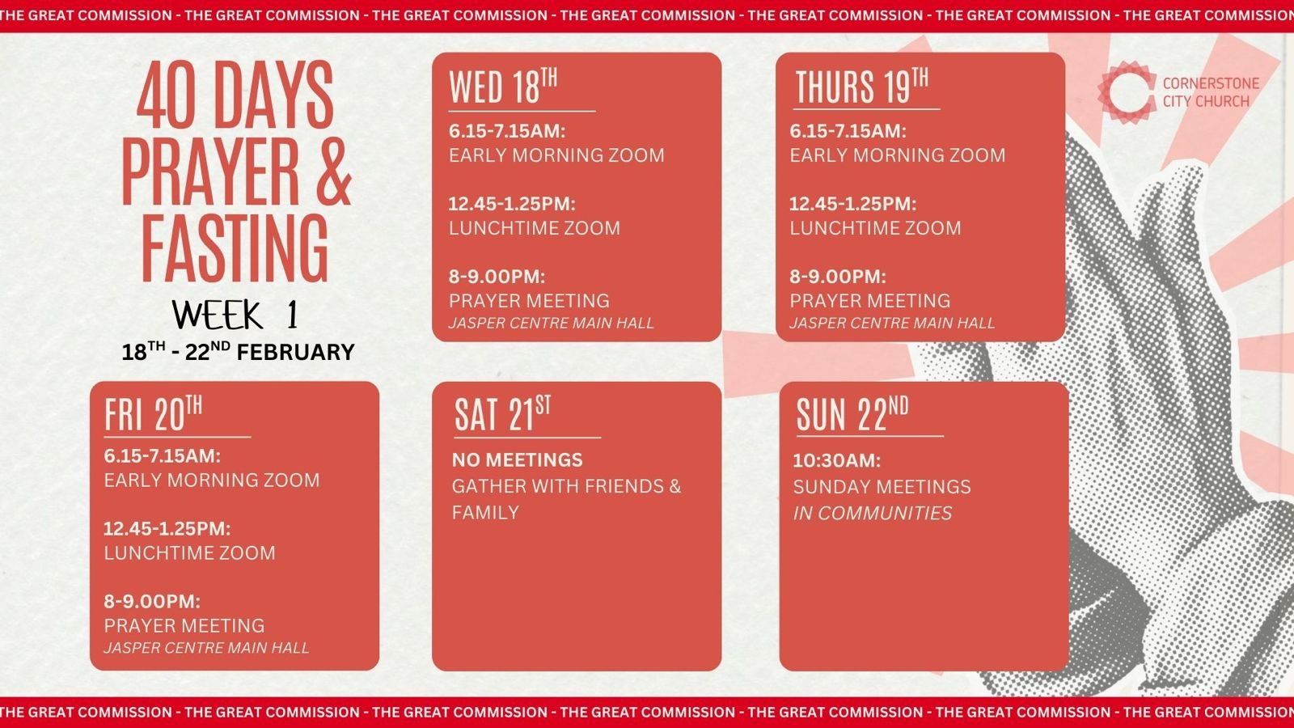

Slide 36


Slide 37
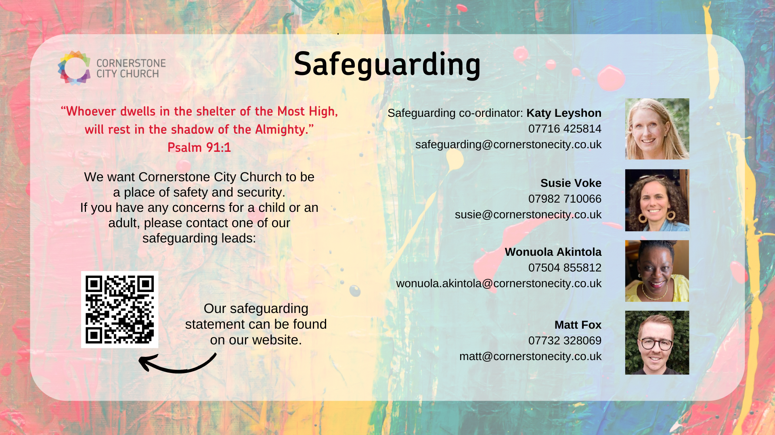

Slide 38


Slide 39


Slide 40
2 Corinthians 14 May the grace of the Lord Jesus Christ, and the love of God, and the fellowship of the Holy Spirit be with us all. And….
Surely goodness and mercy shall follow us all the days of our lives, and we shall dwell in the house of the Lord forever.

